Slide 1
RTLB Principal and Cluster Management Induction
Expectations and Support
February 2012

Slide 2
Vision: Every child & every student learning & achieving every day
Goals
Accelerating student achievement, particularly Māori, Pasifika, students with special education needs
Every child achieves literacy and numeracy skills (learning foundation)
Every young person has the skills and qualifications to contribute to their future, and New Zealand's future
Māori achieving educational success as Māori
All students achieving NCEA level 2 or equivalent
Increasing participation in quality Early Childhood Education
Notes:
Our vision is for ‘Every child & every student, learning & achieving every day’.
The goals to achieve this are:
Accerating student achievement, particularly Māori, Pasifika, students with special education needs
Every child achieves literacy and numeracy skills, which is a learning foundation for education
Every young person has the skills and qualifications to contribute to their future, and New Zealand's
And Māori achieving educational success as Māori
All students achieving NCEA level 2 or equivalent – to ensure we are preparing our students for a successful entry into further studies or work and equipping them with a solid learning foundation to be successful

Slide 3
Focus on Student Achievement
We have an education system that serves most of our students really well.
The New Zealand Curriculum, Te Marautanga o Aotearoa, Ka Hikitia, Pasifika Education Plan and Success for All, Positive Behaviour for Learning create a strong foundation for reaching our goal of raising the achievement of all.
Regional teams focussed on providing leadership and support to schools and kura.

Slide 4
RTLB Integrated planning and delivery
Communication& relationship leadership & local priorities
District/regional & national
National priorities, Ministry contract and support & federation
Cluster governance & management
Cluster processes and systems
RTLB practice
Learners and achievement
With others & Community, Whanau, Iwi
Change Management & Leadership
Fund management and RTLB & practice leadership
Needs analysis, planning and reporting & advisory group
Referral processes
RTLB recruitment, training
Performance agreements
RTLB PLD
Teachers and schools
Individuals
Notes:
Students are at the centre of all that we doing.
It is the responsibility of the sector and the Ministry to ensure we provide support and resources to enable every student to succeed.
To enable this to happen, Ministry regional and local offices are working more closely with schools and kura, to provide and identify support, monitor performance and identify where resources are required to accelerated student achievement
Together, regions assist schools to help improve performance, ensure parents, family and whanau are engaged and supportive, as well as meeting community and ministry expectations.

Slide 5
For 2012
Continuity of services to learners and schools
Transition adminstrivia (important but at times tedious – HR, finance planning)
Focus on core structures, systems and processes, planning and reporting systems, referral processes
Change management – focus on future, building on what has been effective, engaging and involving the RTLB team in change
Developing consistency – between clusters, regionally and nationally, national and local initiatives prioritised and delivered on

Slide 6
For 2012 cont’d
Establish regional and national structures
Good communication with schools and others
Effective and positive local, regional and national relationships with the Ministry
Personnel leadership, planning and deployment – PLD prioritised, transitioning positions between clusters, establishing teams, practice leaders
Focus on Maori and Pasifika

Slide 7
For 2012 cont’d
Support for national tools development
Continued support in transformation – NZSTA, website, other??
Establish processes for better planning for 2013
Confident in needs analysis and establishment of cluster advisory group
Year 11-13 funding process
Prevent re-inventing the wheel

Slide 8
Ministry expectations - Toolkit
Focus on student potential and results
Effective systems and processes
Informed by evidence – research and local data
Sound planning and analysis
Referral processes - fair, transparent, needs based
Māori responsive
community, whanau, access, immersion, personnel, service/practice, results
Pasifika responsive

Slide 9
Ministry Expectations - Toolkit
Cluster governance
Cluster Management
Access to service and service provision
Relationships – schools, learners, parents, Ministry, other agencies
National priorities and responsive and well informed local priorities
Effective stewardship of funding and resources

Slide 10
The Lead School will:
have overall accountability for the provision of the RTLB service in the cluster
manage the governance and accountability framework within the cluster in accordance with the Treaty of Waitangi
employ the RTLB in the cluster
ensure that the cluster operates within the terms of the RTLB Toolkit
provide governance for the cluster
not assign its obligations under this Agreement to other individuals, schools, or entities
provide evidence to the Ministry of the performance of the cluster

Slide 11
Cluster governance Performance is assessed according to the following
The Cluster Annual Strategic Plan is lodged on time and is
acceptable to the Ministry of Education.
The Cluster Annual Report is lodged on time and is
acceptable to the Ministry of Education.
Success meeting the objectives in the Strategic Plan outlined in the Annual Report to the Ministry of Education.
Feedback from the Education Review Office (ERO) and
Ministry staff and other schools in the cluster.
Student outcomes
Clear evidence that cluster funds have been used for their
assigned purposes and allocated according to need.

Slide 12
Cluster Management Performance is assessed according to the following
Success meeting the objectives in the Strategic Plan as
recorded in the Annual Report to the Ministry of Education.
Feedback from ERO and Ministry staff.
Cluster Annual Reports to the Ministry which include:
o Feedback from other schools in the cluster.
o Evidence of the quality of the planning processes in place.
o The documentation that underpins self-review, planning
and reporting.
o Evidence of improved student outcomes.
o Reference to the practice of individual RTLB in the cluster.

Slide 13
Access to the Service and Service Delivery Performance is assessed according to the following
according to the quality of the data-gathering systems in place
based on improvements in teacher capability and confidence
based on student outcomes
by ERO reporting
according to the information in the Cluster Annual Report
which will include feedback from other schools in the cluster.

Slide 14
Relationships Performance is assessed according to the following
the documentation that records management planning and
review
the communication which supports cluster-wide management
the reports by ERO and feedback from Ministry staff
the information in the Cluster Annual Report which will
include:
o feedback from other schools in the cluster
o the extent that the cluster developed effective networks
o feedback from parents/whānau
o feedback from individual RTLB.

Slide 15
National priorities Performance is assessed according to the following
.
protocols for delivery included in the Incredible Years Teacher Practice Manual (including regular supervision with appropriately accredited staff) · the fidelity expectations of the international Incredible Years Teacher Programme developed by Carolyn Webster-Stratton
a nationally agreed referral process between the RTLB service and Ministry of Education, Special Education services
the provision of education assessments for students entering into the care of Child, Youth and Family.

Slide 16
Operational documents from 2011 annual reports
There is one plastic folder for each of the new clusters. – The new cluster number is on the front of the plastic folder.
Please note, we haven’t received op docs from every old cluster, but have sent on what we received. The Ministry doesn’t need these documents to be returned.
Tentative financial information from 2011 annual reports
This is the information we have from the 2011 clusters– summarised up to the new clusters. For some clusters there isn’t any information and this is indicated.
Expense claim forms and the instructions for travel/meal costs that MoE will met
In one of the white envenlopes attached to the boxes you will find 70 information sheets about expenses and travel claim forms – for the participants to claim meals etc
2011 annual report summaries
These are still being analysed – very close to being completed. They will be emailed out next week to the lead school principals or cluster managers that we have info for

Slide 17
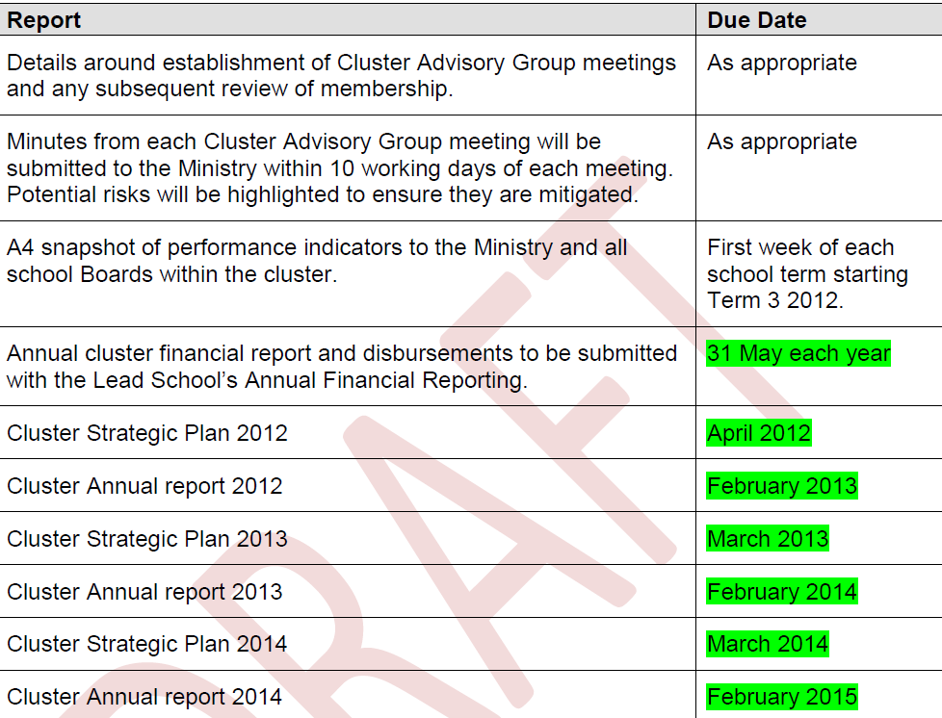

Slide 18
Notes:
We are making some changes to the RTLB TKI website.
In the next week or so, this…

Slide 19
(example content only)
Notes:
will be replaced with this…..
Look and feel of RTLB toolkit
Will have links to Special Education (SE online)

Slide 20
Other boxes yet to be added. For example, the RTLB appointment process and form.
This will link to Virtual Learning Networks (see next slide).
Notes:
Purpose of Management section:
We’ll be putting up templates and tools for Cluster management to use to support the implementation of the RTLB toolkit.
The Calendar will show when important dates for the RTLB service are coming up. For example, reporting dates, trainings etc.

Slide 21
http://www.vln.school.nz/
Notes:
The Virtual Learning Network is a place where groups can be formed online.
For example, all Cluster Managers could form a group to network and share ideas.
Clusters could form groups where RTLB in a cluster and Cluster Managers can have discussions.
Nationally, RTLB with specific interests, for example working in Kura, could form a network for sharing successes and ideas.

Slide 22
Example of a discussion on a VLN.
Notes:
The VLN can allow for video sharing and document sharing as well as discussions.

Slide 23
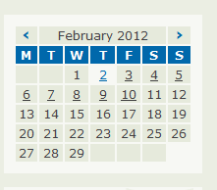
The calendar function visible throughout the website.
Underlined dates will indicate that this is a date where something is happening.
Notes:
Clicking on an underlined date will take the user to information about the event.

Slide 24
Type in any school name.
Lead school contact information will appear.
Notes:
We want to make it easier for whānau, parents and interested people to talk to their local RTLB service.
This part of the site makes it easier for whānau, parents or anyone interested, to find out how to contact their local RTLB service.
The search result will be the name of the lead school or cluster manager associated with that school’s cluster (or contact details that you tell us you’d like available).

Slide 25
http://seonline.tki.org.nz/
Notes:
Strong links through to Special Education online.
To help reinforce the joint approach to supporting schools and students.
Sharing resources – for example IEP guidelines.

